Slide 1
SRI RAMAKRISHNA ENGINEERING COLLEGE
[Educational Service : SNR Sons Charitable Trust]
[Autonomous Institution, Reaccredited by NAAC with ‘A+’ Grade]
[Approved by AICTE and Permanently Affiliated to Anna University, Chennai]
[ISO 9001-2015 Certified and all eligible programmes Accredited by NBA]
VATTAMALAIPALAYAM, N.G.G.O. COLONY POST, COIMBATORE – 641 022.
Department of Electronics and Communication Engineering
20EC214 & DIGITAL CMOS VLSI CIRCUITS
Course Instructor:
Mr.R.Chandru,
Assistant Professor(Sl.G)/ECE
No. of Credits : 3

Slide 2
20EC214 - DIGITAL CMOS VLSI CIRCUITS COURSE OUTCOMES
On successful completion of the course, students will be able to,
COURSE OUTCOMES
CO₁ | Interpret the characteristics and manufacturing process technologyof MOS transistor.
CO₂ | Analyze the various logic styles of CMOS combinational andsequential circuits
CO₃ | Design the various digital arithmetic logic circuits.
CO₄ | Illustrate the performance of the digital circuits by examining the timing issues.
CO₅ | Make use of MOS concepts in construction of Memory Array Subsystem.

Slide 3
20EC214 - DIGITAL CMOS VLSI CIRCUITS COURSE CONTENTS
PREREQUISITES
20EC204 - Digital System Design
MOS TRANSISTOR AND PROCESSING 10
MOSFET theory - Transistor switches - Compound gates - Design equations - IV characteristics - CV characteristics - Second order effects - Energy and Power - Resistance Estimation - Capacitance Estimation - Switching Characteristics - RC Delay Models - Logical Effort for gates - CMOS Process technology - Design Rules and Layout.
CMOS LOGIC STRUCTURES 11
Combinational Circuits: CMOS Inverter - DC Characteristics - Complementary Logic Structures - Ratioed logic - Pass transistor logic - Transmission gate - Tristate Inverter - Multiplexers - Dynamic logic structures. Sequential Circuits: Static latches and Registers, Dynamic latches and Registers, Pulse Registers, Sense Amplifier Based Register, Pipelining.
DESIGN OF ARITHMETIC BUILDING BLOCKS 8
Full adder, Ripple carry adder, Carry bypass adder, Linear and Square root carry-select adder, Carry look-ahead adder - Multipliers - Barrel and logarithmic shifter.
TIMING ISSUES 8
Timing Basics, Sources of Skew and Jitter, Clock-Distribution Techniques, Latch-Based locking, Self-Timed Circuit Design, Synchronizers and Arbiters, Clock Synthesis and Synchronization Using a Phase-Locked Loop.
MEMORY ARRAY SUBSYSTEM 8
SRAM: SRAM Cells, Row Circuitry, Column Circuitry. Multiported SRAM and Register files DRAM: Subarray Architectures, Column Circuitry, Embedded DRAM. Read-Only Memory: Programmable ROMs, NAND ROMs, Flash.

Slide 4
20EC214 - DIGITAL CMOS VLSI CIRCUITS COURSE CONTENTS
TEXT BOOKS
Neil H.E. Weste and David Harris, "CMOS VLSI Design A Circuits and Systems Perspective", 4th Edition, Pearson Education, Reprint 2010.
Jan M. Rabaey, Anantha Chandrakasan and B Nikolic, "Digital Integrated Circuits: A Design Perspective", 2nd Edition, Pearson Education India, 2016.
REFERENCES
Douglas. A. Pucknell, Kamran Eshraghian, "Basic VLSI Design", 3rd Edition, Prentice Hall India, 2010.
John P.Uyemura, "Introduction to VLSI Circuits and Systems", John Wiley & Sons, 2012.
WEB REFERENCES
https://nptel.ac.in/courses/108/107/108107129/
https://nptel.ac.in/courses/117/106/117106093/

Slide 5
MODULE 3 DESIGN OF ARITHMETIC BUILDING BLOCKS
□ Full Adder
□ Ripple Carry Adder
□ Carry Bypass Adder
□ Carry Select Adder
□ Square Root Carry Select Adder
□ Carry Look-Ahead Adder
□ Multipliers:
Array Multiplier
Booth Multiplier
Wallace Tree Multiplier
□ Shifters:
Barrel Shifter
Logarithmic Shifter

Slide 6
MODULE 3 DESIGN OF ARITHMETIC BUILDING BLOCKS
Need for Fast Adders
Addition is the most frequently used operation in digital systems
Performance of processors depends on adder speed
Basic adder: Ripple Carry Adder (RCA)
Delay increases with number of bits
RCA suffers from carry propagation delay
Therefore faster adder architectures are required

Slide 7
MODULE 3 DESIGN OF ARITHMETIC BUILDING BLOCKS
Ripple Carry Adder Problem
Each full adder must wait for carry from previous stage
Carry propagates sequentially from LSB to MSB
For an N-bit adder, delay is proportional to N
Worst-case delay occurs when carry propagates through all stages
This limits performance in high-speed processors

Slide 8

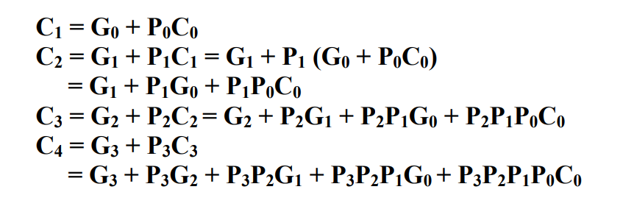



MODULE 3 DESIGN OF ARITHMETIC BUILDING BLOCKS
Carry look-ahead adder

Slide 9
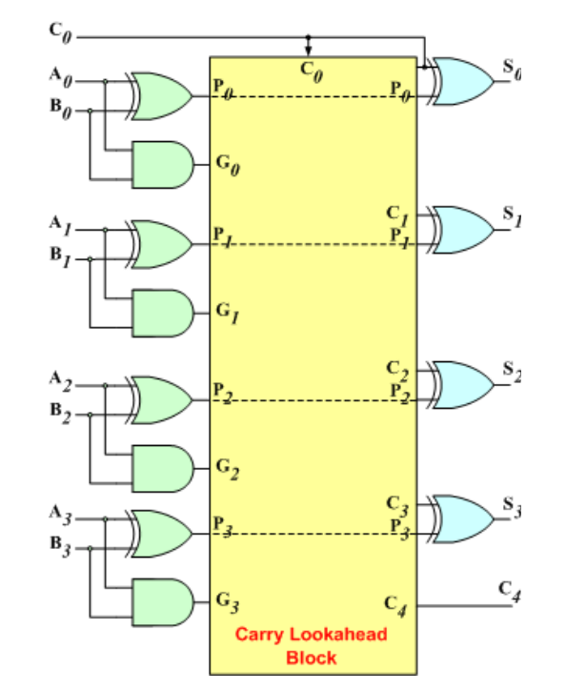
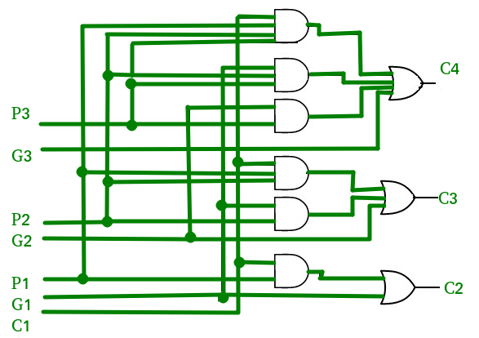
MODULE 3 DESIGN OF ARITHMETIC BUILDING BLOCKS

Slide 10
MODULE 3 DESIGN OF ARITHMETIC BUILDING BLOCKS
Carry Select Adder
Carry Select Adder reduces carry propagation delay
Computes results for two possible carry inputs
Case 1: Carry input = 0
Case 2: Carry input = 1
Both results are calculated simultaneously
A multiplexer selects the correct output
Instead of waiting for carry:
Perform two additions
Assume carry input = 0
Assume carry input = 1
Store both results
Once actual carry arrives, select correct result
This significantly reduces carry waiting time

Slide 11
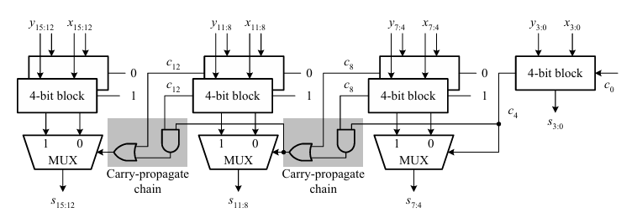
MODULE 3 DESIGN OF ARITHMETIC BUILDING BLOCKS
Carry Select Adder

Slide 12
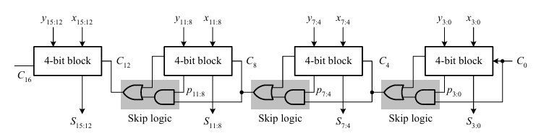
MODULE 3 DESIGN OF ARITHMETIC BUILDING BLOCKS
Carry Skip Adder

Slide 13
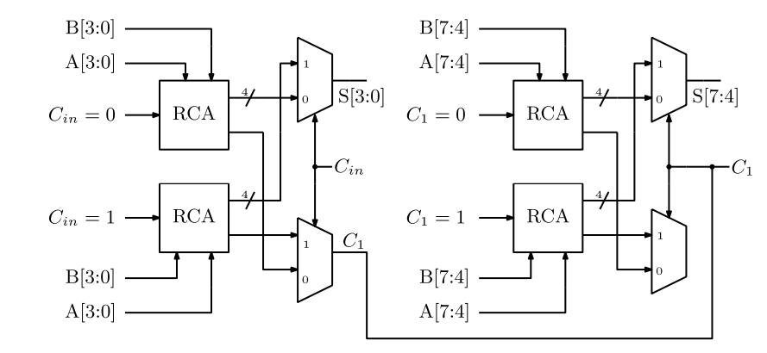
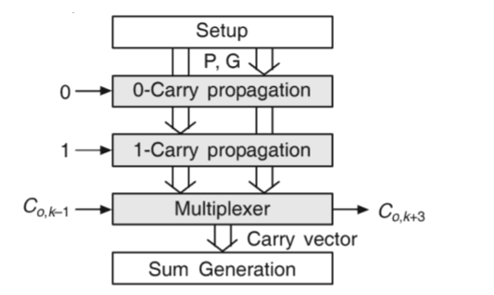
MODULE 3
Design of Arithmetic Building Blocks
A schematic of 4-bit carry select adder

Slide 14
MODULE 3
Design of Arithmetic Building Blocks
Critical Path Delay
The critical path is the longest delay path from input to output in a digital circuit.
The critical path delay determines the maximum speed of the circuit.
In a Ripple Carry Adder, the carry must propagate through all full adders.
If one full adder carry delay = t carry
Then total delay:
t=4×t carry
This entire carry chain is the critical path.

Slide 15
MODULE 3
Design of Arithmetic Building Blocks
Critical Path in Linear Carry Select Adder
Critical path contains:
First block ripple carry delay + multiplexer delays + final sum generation
Ripple carry (block1)
↓
MUX
↓
MUX
↓
MUX
↓
Sum
In Carry Select Adder, we divide the adder into blocks so that the ripple carry delay of the first block and the multiplexer delay are balanced.
Ripple delay (first block) + multiplexer delays

Slide 16

MODULE 3
Design of Arithmetic Building Blocks
4-bit Linear Carry Select Adder
4-bit Ripple Carry Adder (RCA)
FA0 → FA1 → FA2 → FA3
Block 1 : bits 0–1 → 2-bit ripple adder
Block 2 : bits 2–3 → carry select block
Ripple carry through 2 full adders
Total delay = 4 units
Delay = 2 units

Slide 17
MODULE 3
Design of Arithmetic Building Blocks
Square Root Carry Select Adder
Two delays exist in CSA
A Square Root Carry Select Adder is a modified Carry Select Adder in which the block sizes are not equal. The blocks increase gradually (1, 2, 3, 4 … bits) so that the carry generation delay and multiplexer delay are balanced, reducing the overall addition time.
Ripple carry delay
Multiplexer delay
In Linear CSA:
Ripple delay decreases
MUX delays increase
So total delay becomes large
Square Root CSA balances both delays

Slide 18
MODULE 3
Design of Arithmetic Building Blocks
Feature | Ripple Carry Adder | Carry Skip Adder | Linear Carry Select Adder | Square Root Carry Select Adder | Carry Look Ahead Adder
Basic Idea | Carry ripples through all stages | Carry can skip a block if propagate signals are true | Two sums computed assuming carry = 0 and 1 | Improved CSA with increasing block sizes | Carry is predicted using generate and propagate logic
Structure | Series of full adders | Ripple blocks + skip logic | Equal sized blocks with two RCAs + MUX | Increasing block sizes (2,3,4,5…) | Parallel carry generation logic
Carry Propagation | Sequential | Ripple + skip path | Parallel computation + MUX selection | Balanced ripple + MUX delay | Parallel carry computation
Speed | Slowest | Faster than RCA | Faster than CSKA | Faster than Linear CSA | Fastest for small bit adders
Hardware Complexity | Very low | Low to moderate | Moderate | Moderate | High
Area | Small | Slightly larger than RCA | Larger (two RCAs per block) | Similar to CSA | Large
Power Consumption | Low | Moderate | Moderate | Moderate | High
Design Complexity | Very simple | Simple | Medium | Medium | Complex
Delay Growth | Linear with number of bits | Reduced compared to RCA | Reduced using carry selection | Balanced delay for better performance | Logarithmic carry computation
Typical Block Pattern | No blocks | Blocks with skip logic | Equal blocks (4-4-4-4) | Increasing blocks (2-3-4-5) | No blocks (parallel carry network)
Best Use Case | Small circuits | Medium speed designs | High-speed arithmetic | High-speed large adders | High performance processors

Slide 19
MODULE 3
SHIFTERS
Introduction
□ Shift operations are important in arithmetic and logic operations
□ Used for data movement and bit manipulation
□ Implemented using combinational logic circuits
□ Used in ALU operations like multiplication and division
Basic Shift Operations
□ Shift operation moves bits left or right
□ Vacant positions are filled with 0 or sign bit
□ Two types of shift operations:
Logical Shift
Arithmetic Shift

Slide 20
MODULE 3
SHIFTERS
Logical shift.
In the logical shift operation, the vacant bits are filled with 0s. Depending on the shift direction, it can be further divided into the following two types. • Logical left shift: The input is shifted left a specified number of bit positions and all vacant bits are filled with 0s
• Logical right shift: The input is shifted right a specified number of bit positions and all vacant bits are filled with 0s.
Arithmetic shift. The basic feature of an arithmetic shift is that the shifted result is the input number divided by 2 when the operation is right shift and is the input number multiplied by 2 when the operation is left shift. More formally, arithmetic shift can be subdivided into the following two types. • Arithmetic left shift:
The input is shifted left a specified number of bit positions and all vacant bits are filled with 0s. Indeed, this is exactly the same as logical left shift.
• Arithmetic right shift: The input is shifted right a specified number of bit positions and all vacant bits are filled with the sign bit

Slide 21
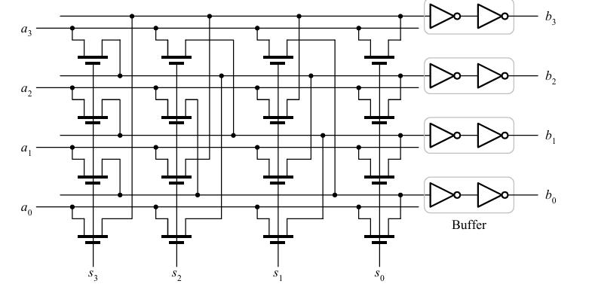
MODULE 3
left-rotation linear barrel shifter

Slide 22
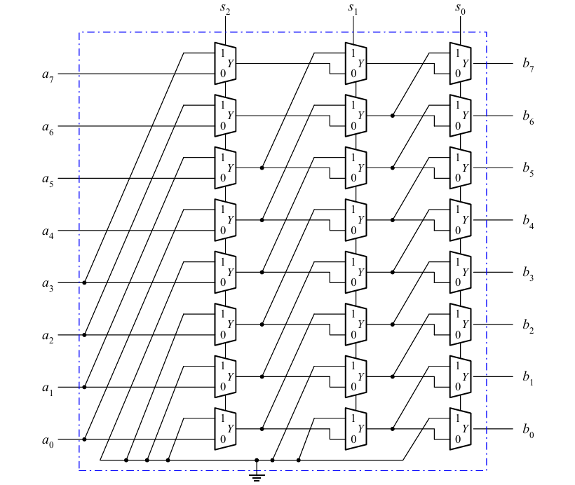
MODULE 3
logarithmic barrel shifter
An example of a logical/arithmetic-left logarithmic barrel shifter based on 2-to-1multiplexers.

Slide 23

MODULE 1 MOS TRANSISTOR AND PROCESSING TECHNOLOGY

